Slide 1

Indian Institute of Information Technology, Allahabad
BTech IT, VI Semester
Mini Project
Autism Detection in children via Image Processing
Under the Supervision of :
Dr Vrijendra Singh
Submitted by:
IIT2018018 ( Archisha Baranwal)
IIT2018117 ( Palak Mittal )
IIT2018119 ( Nehal Singh)
IIT2018191 ( Puja Kumari)
IIT2018195 ( Prabha Kumari)

Slide 2
Introduction
Autism Spectrum Disorder (ASD) is a neuro - disorder in which a child or a person has a lifelong effect on interaction and communication with others .
Although no cure exists for autism spectrum disorder , and there is no one-size fits-all treatment.
The only treatment is to maximize child’s ability to function by reducing ASD symptoms and supporting development and learning.
We are going to use CNN (convolutional Neural network) classifier to train our model to detect autism from a facial image .

Slide 3
Problem Statement
Image Based Autism Detection using eye movements and fixation time.
We have given facial images of autistic and non-autistic children. We have to train the model using some of the dataset .
For training we can use any method line - KNN, CNN, SVM, Naive Bayes classifier but we have proposed CNN method as it is giving best accuracy.
After training we have to test our model to detect autism from facial image.

Slide 4
Literature review - 1 ^{[1]}
The major reference has been taken from paper titled Visualization of Eye-Tracking Patterns in Autism Spectrum Disorder: Method and Dataset
Thirteenth International Conference on Digital Information Management (ICDIM) on 24-26 Sept. 2018
Conference Location: Berlin, Germany, Germany
Aim of this paper is to visualize the eye-tracking patterns of ASD-diagnosed individuals with particular focus on children at early stages of development.
The promising prediction accuracy achieved by a simple logistic regression model evidently demonstrated the validity and applicability of our methodology.

Slide 5
Literature review - 2 ^{[2]}
Paper Title : Learning Clusters in Autism Spectrum Disorder: Image-Based Clustering of Eye-Tracking Scanpaths with Deep Autoencoder
41st Annual International Conference of the IEEE Engineering in Medicine and Biology Society (EMBC).) held on 23-27 July 2019 at Berlin , Germany.
Aim of this conference was to apply unsupervised machine learning to discover clusters in Autism Spectrum Disorder (ASD).
Its results provided a set of implications to be considered. First, the clustering experiments empirically confirmed that eye-tracking scanpaths could be grouped into coherent clusters, which largely resembled the original grouping of samples (i.e. ASD or non-ASD).

Slide 6
Literature review - 3 ^{[3]}
Paper Title : Learning to Predict Autism Spectrum Disorder based on the Visual Patterns of Eye-tracking Scanpaths.
Conference :12th International Conference on Health Informatics held on February 2019
Conference Location: Prague, Czech Republic
This paper presents an approach to help with the ASD diagnosis with a particular focus on children at early stages of development.
This paper use the methodology transform eye-tracking scanpaths into a visual representation, and hence the diagnosis can be approached as an image classification task .

Slide 7
Literature review - 4 ^{[4]}
The reference has been taken from paper titled Early detection for autism spectrum disorder in young children.
Article : Paediatrics & Child Health, Volume 24, Canada, Issue 7, November 2019, Pages 424–432
Date of Conference :24 Oct 2019
This paper statement provides clear, comprehensive, evidence-informed re-commendation and tools to help community paediatricians and other primary care providers .
This paper describes the result on canadian children.It provides the general information of ASD.
This paper gave an overview of data with the help of canadian children and described the information of research in a beautiful manner.

Slide 8
Literature review - 5 ^{[5]}
Paper Title : Evaluating the EEG and Eye Movements for Autism Spectrum Disorder .
2018 IEEE International Conference on Big Data (Big Data)
Date of Conference:10-13 Dec. 2018
Conference location:Seattle, WA, USA
This paper presents an analysis and comparison between EEG, Eye and combined data.
They have compared four models,two models were created for each model with only EEG and combined data by using PCA and without using PCA, Like SVM with PCA and without PCA .

Slide 9
Literature review - 6 ^{[6]}
Paper Title : Automatic Detection of Autism Spectrum Disorder by Tracking the Disorder Co-morbidities
2019 9th Annual Information Technology, Electromechanical Engineering and Microelectronics Conference (IEMECON)
Date of Conference: 13-15 March 2019
Conference Location: Jaipur, India
This main aim of this to paper provide insights into the mechanism underlying risk-perception in ASD.
The SSD was calculating by computing the difference between the median risky and medium neutral response.

Slide 10
Literature review - 7 ^{[7]}
Paper Title : A Review of Early Detection of Autism
Based on Eye-Tracking and Sensing Technology
2020 International Conference on Inventive
Computation Technologies (ICICT)
Date of Conference: 26-28 Feb. 2020
Conference Location: Coimbatore, India
The main aim of this to paper to detect and monitor ASD in the early stage of life using eye-tracking and sensing technologies
The eye-tracking technique allow psychologists to diagnose ASD by monitoring eye movement for a short time and analyze the eye fixation of ASD.

Slide 11
Literature review - 8 ^{[8]}
Paper Title : Predicting Autism Diagnosis using Image with Fixations and Synthetic Saccade Patterns
2019 IEEE International Conference on Multimedia & Expo Workshops (ICMEW)
Date of Conference: 8-12 July 2019
Conference Location: Shanghai, China
This paper describes the predictions of ASD diagnosis using gaze data.
In this paper, we propose two machine learning methods, synthetic saccade approach and image based approach, to automatically classify ASD given the scanpath data from children on free viewing of natural images

Slide 12
Objective & Scope
Our aim is to develop a basic binary classifier model for discriminating the two classes of facial image.
We have to train the classifier that can predict the class of participants into Autistic(1) and Non-Autistic (0) using CNN (Convolutional Neural Network).
This model can be used in medical field for detecting autism. In future , we can make it more efficient by using algorithm so that we can get at least more than 95 % accuracy.

Slide 13
CNN
Input Image
Convolutional Layer
Max Pooling
Flattening
Full Connection
Output Image
Unlike regular Neural Networks, in the layers of CNN, the neurons are arranged in 3 dimensions: width, height, depth. The neurons in a layer will only be connected to a small region of the layer (window size) before it, instead of all of the neurons in a fully-connected manner.
Moreover, the final output layer would have dimensions (number of classes), because by the end of the CNN architecture we will reduce the full image into a single vector of class scores.

Slide 14
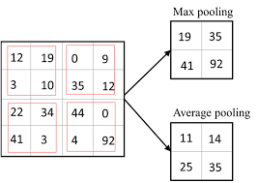
The components of a CNN are as detailed below:
1. Convolution Layer :
In convolution layer we take a small window size (typically of length 3*3) that extends to the depth of the input matrix. During every iteration we slid the window by stride size,, and computed the dot product of filter entries and input values at a given position. That is, the network will learn filters that activate when they see some type of visual feature such as an edge of some orientation or a blotch of some color.
2. Pooling Layer :
We use a pooling layer to decrease the size of the activation matrix and ultimately reduce the learnable parameters.
There are two type of pooling :
a) Max Pooling
b) Average Pooling

Slide 15
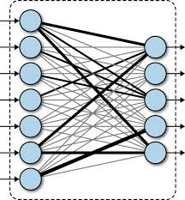
3. Fully Connected Layer :
In convolution layer neurons are connected only to a local region, while in a fully connected region, we connect all the inputs to neurons.
4. Final Output Layer :
After getting values from the fully connected layer, we connect them to the final layer of neurons (having count equal to total number of classes), that will predict the probability of each image to be in different classes.

Slide 16

VGG16
VGG16 is a convolution neural net (CNN )
architecture which we would be using.
It is considered to be one of the excellent vision
model architecture till date. Most unique thing
about VGG16 is that instead of having a large
number of hyper-parameter they focused on
Having Convolution layers of 3x3 filter with a
stride 1 and always used same padding and
maxpool layer of 2x2 filter of stride 2.
It follows this arrangement of convolution and
max pool layers consistently throughout the
whole architecture. In the end it has 2 FC(fully
Connected layers) followed by a softmax for
output. The 16 in VGG16 refers to it has 16 layers that have weights.
This network is a pretty large network and it has about 138 million (approx) parameters.

Slide 17
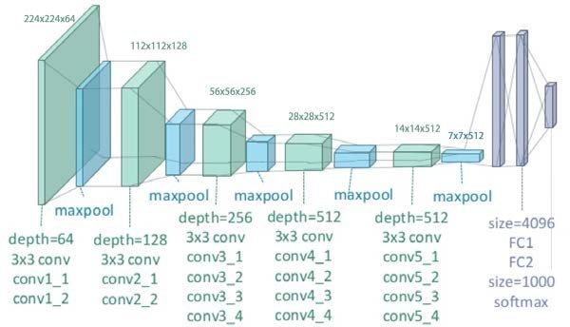
VGG19
VGG19 is a variant of VGG model which in short consists of 19 layers (16 convolution layers, 3 Fully connected layer, 5 MaxPool layers and 1 SoftMax layer).
The VGG19 network uses only five types of layers. All convolution layers use 3 × 3 kernels and all max pool layer use 2 × 2 kernels. 19 counts only the convolution and fully connected layers. Due to the presence of fully connected layers, VGG-19 is not fully convolutional and therefore, will only be able to accept 224 × 224 × 3 inputs without retraining.

Slide 18
Methodology
Load Train dataset: First, we will start by training our dataset. Our dataset contains the file with file names as “Non_Autistic.135.jpg , Autistic.391.jpg”, where the word is splitted by ‘.’, initial word describes the kind (whether the person is autistic or not and next word describes the image no.).
Load Test dataset: Our dataset contains the file with file names as “Non_Autistic.135.jpg , Autistic.391.jpg”
We will be using Multi layer neural networks as deep neural networks.
Since the dataset consists of images ,Convolutional neural networks will be used.
The CNN classification is a technique to segregate the data according to different categories. Each time an image is passed, it will go through a number of convolutional layers and filters.

Slide 19

Preparing Model: Then, we will prepare the model following the steps given below:
We will define hyperparameters
Then Flatten the output layer to 1 dimension
Further we will add a fully connected layer with 512 hidden units and ReLU activation
Next a dropout rate of 0.5 will be added
Lastly a final sigmoid layer for classification will be added
Preprocessing of Data: We will be preprocessing data and extracting data from images in the form of matrix.
Preparing the training dataset:
Training Generator: Here we will be preparing and generating the train data.
Validation Generator: We will be creating a validation generator to filter out the data to ensure the quality of performance by using the validate data.
validation_data: Data on which to evaluate the loss and any model metrics at the end of each epoch. The model will not be trained on this data.

Slide 20
Now, we will use two different models of CNN to predict the results, that ar VGG16 and VGG19.
Model Fitting: Now we will train the data for a fixed number of epochs and batch size.
Preparing the testing dataset: We will create a testing generator for generating the test dataset using the previously loaded test images.
Prediction: Now, we will be predicting the result for the test dataset and using the model evaluated earlier.
Output will be as follows :
Image name as :- actual_name(image name{0 or 1}) , eg. autistic.127.jpg(1) , here 0/1 is prediction.
Our predictions will next go to submission_13010030.csv.
This file contains the predicted result, and further we will calculate its accuracy , precision etc.

Slide 21
Flowchart
Load Train Dataset
Load Test Dataset
Prepare Model
Process Data
Prepare the testing dataset
Model Fitting
Prepare the training Dataset
Prediction
Create Confusion Matrix
Calculate Results

Slide 22
Experimental Data Description
Dataset (Name/ Description) | Characteristics of dataset | Public URl
Learning to predict autism spectrum disorder based on the facial image | This dataset includes visualizations of facial image with a particular focus Autism Spectrum Disorder (ASD). | https://www.kaggle.com/gpiosenka/autistic-children-data-set-traintestvalidate

Slide 23
Dataset Explanation
Our dataset includes visualizations of facial image with a particular focus on Autism Spectrum Disorder (ASD). In the dataset, 0 is representation for Autisitic and 1 is representation for Non Autisitic. The data is provided in the consolidated directory.
The dataset descriptions are as follows:-
Train: Train dataset images used to prepare and train our model.
Test: Test dataset images used to test our model and then we measure performance of our model.
Valid: Valid dataset used to provide an unbiased evaluation of a model fit on the training dataset while tuning model hyperparameters.

Slide 24
Activities of children during photo capturing
Repeat words,phrases from television or movies
Repetitive activities with objectives like pencils ,toys figures
Repetitive body , arm,hand of fingers movement.
During sharing of interests , achievements or emotions.
During eye contact to communicate.
Unusual reactions with smells , sounds ,taste.
During playing with peers.
There are also many more activities during which those dataset images are clicked.

Slide 25
Languages & Libraries
Language
Libraries
Tools
Python
Numpy
Pandas
Matplotlib
SKlearn
Seaborn
Os
Layers
Optimizer
Model
VGG16
Keras
TensorFlow
PIL

Slide 26
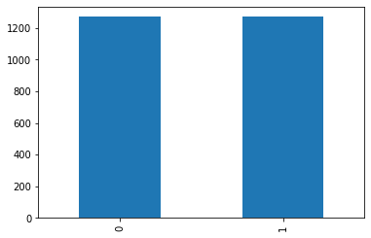
Implementation
Train dataset: We have classified the dataset as category (0,1) as (Non Austistic , Austistic) respectively.
filename category
0 Non_Autistic.135.jpg 0
1 Non_Autistic.1211.jpg 0
2 Non_Autistic.261.jpg 0
3 Autistic.999.jpg 1
4 Non_Autistic.1227.jpg 0
2539 Autistic.303.jpg 1
Test dataset: Here we will load the test dataset
which will consist of only filename.
Filename
0 Autistic.135.jpg
1 Autistic.27.jpg
2 Autistic.14.jpg
3 Autistic.88.jpg
4 Autistic.17.jpg

Slide 27
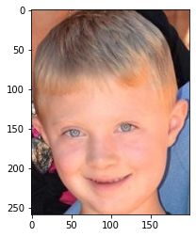
Implementation (Contd)
Sample Image: Now, we will load the sample image as given below:
( image2.jpg)
Model was prepared with hyperparameters as epochs = 20 and batch_size =12.
Model was compiled with :
model.compile(loss='binary_crossentropy',
optimizer=optimizers.SGD(lr=1e-3, momentum=0.9),
metrics=['accuracy'])
Now Model is prepared with output.

Slide 28
Implementation (Contd)
Next data was trained and preprocessed with using parameters as :
rotation_range=15,
rescale=1./255,
shear_range=0.2,
zoom_range=0.2,
horizontal_flip=True,
fill_mode='nearest',
width_shift_range=0.1,
height_shift_range=0.1
Now data will validated and stored in “validation_datagen”
Model fitting was carried out , and for each epoch accuracy and loss was calculated.
Loss and accuracy for model will be : accuracy = 0.865079 ; loss = 0.331409

Slide 29
Implementation (Contd)
Next prediction was made with a threshold as 0.5 .
Our predictions will next go to submission_13010030.csv, which will be as follows:
id | label
Autistic | 1
Autistic | 1
Autistic | 1
Autistic | 1
Autistic | 0
Autistic | 1

Slide 30
Project Timeline
Steps | Time Required | Date and Time
Requirement Verify | ~ | 5th February 2021
Project Planning | 3 days | 8th February 2021
System Design | 7 days | 15th February 2021
Detail Design | 15 days | 28th February 2021
Coding | 10 days | 10th March 2021
Debugging and coding | 15 days | 25th March 2021
Report | 32 days | 28th March 2021
Testing | 5 days | 2nd May 2021
Improvements | 3 days | 5th May 2021
Final | 1 days | 6th May 2021

Slide 31
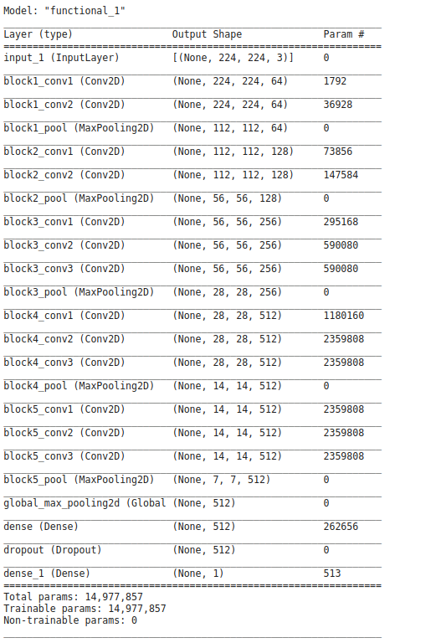
Model Preparation
(VGG16)

Slide 32
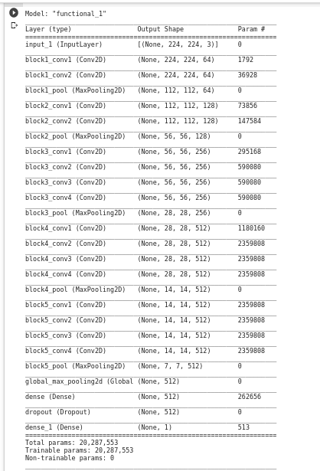
Model Preparation
(VGG19)

Slide 33
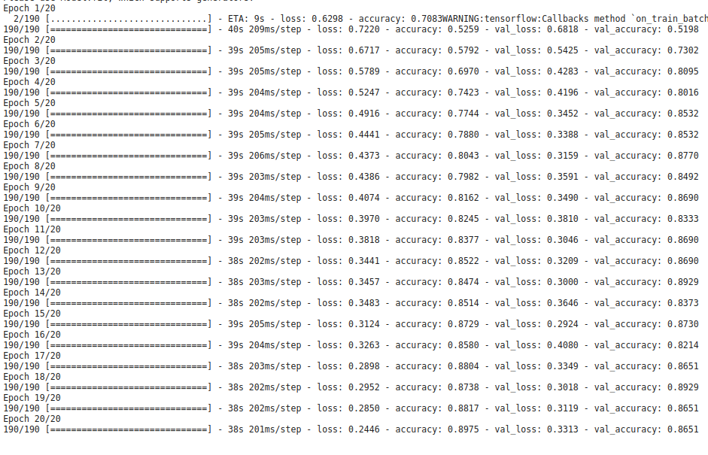
Model Fitting
Image shows the loss and accuracy of 20 iterations.
Neptune
Val_accuracy = accuracy of validation dataset.
Val_loss = losses of validation dataset..
Venus
Mars

Slide 34
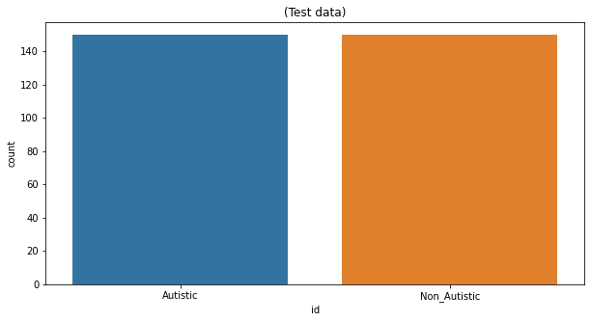
FINAL RESULTS
Graph of Actual Test Data :

Slide 35
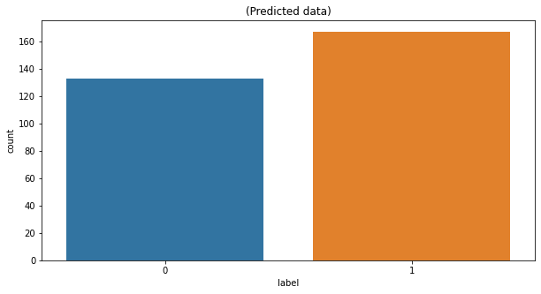
FINAL RESULTS(VGG16)
Graph of Predicted Data :

Slide 36
FINAL RESULTS (VGG16)
Number of images which were classified as :
predicted Autistic : 167
predicted Non Autistic : 133
Actual Autistic : 150
Actual Non Autistic : 150
Percentage of images classified as :
Actual Non Autistic percentage in total test data: 50.0 %
Predicted Non Autistic percentage in total test data: 44.3333333333336 %
Actual Autistic percentage in total test data: 50.0 %
Predicted Autistic percentage in total test data: 55.666666666666664 %

Slide 37
FINAL RESULTS (VGG16)
Confusion matrix was used for predicting accuracy & other results:
True positive : 135
True Negative : 118
false Positive : 15
false Negative : 32
Accuracy is: 84.33333333333334 %
Precision is: 90.0 %
Sensitivity is: 80.83832335329342 %
Specificity is: 88.7218045112782 %

Slide 38
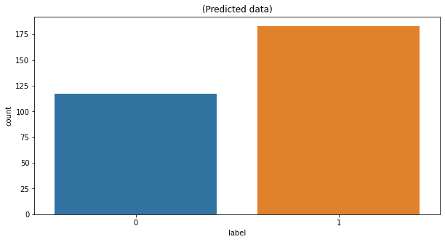
FINAL RESULTS(VGG19)
Graph of Predicted Data :

Slide 39
FINAL RESULTS (VGG19)
Number of images which were classified as :
predicted Autistic : 158
predicted Non Autistic : 142
Actual Autistic : 150
Actual Non Autistic : 150
Percentage of images classified as :
Actual Non Autistic percentage in total test data: 50.0 %
Predicted Non Autistic percentage in total test data: 47.3333333333336 %
Actual Autistic percentage in total test data: 50.0 %
Predicted Autistic percentage in total test data: 52.666666666666664 %

Slide 40
FINAL RESULTS (VGG19)
Confusion matrix was used for predicting accuracy & other results:
True positive : 130
True Negative : 122
false Positive : 20
false Negative : 28
Accuracy is: 84.0 %
Precision is: 86.66666666666667 %
Sensitivity is: 82.27848101265823 %
Specificity is: 85.91549295774648 %

Slide 41
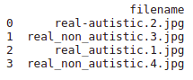
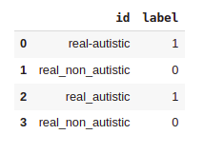
Results from Real Dataset
Here we took the images for the prediction and result calculation from a real dataset that is from the Internet and our own family members. THese images are in the “test2” folder in the Dataset folder.
Dataset : Results :
Dataset Link : https://drive.google.com/drive/u/0/folders/1ubuJjj2Xubajey_d2vmp-hcpR2tWk926

Slide 42
Comparison with Base paper
Base paper has a dataset of 59 participants labelled as ASD-Diagnosed and Non-ASD.
In this base paper , key idea in the methodology is to construct a visual representation of eye motion. They have transformed the eye-tracking records into visual patterns.It appears that the ASD- diagnosed participant had a tendency of looking at the bottom of the screen ,where the eye-tracking device was placed . The data transformation process was fully implemented using python. The visualizations were produced by the Matplotlib library .
We have a dataset of 1470 autistic facial images and 1470 non-autistic facial images . Out of those we are using 1269 images comprising both autistic and non-autistic for training purposes. We have used 149 images for testing the model. We have used VGG16 and VGG19 models of CNN (Convolutional Neural Network) methodology to train the model and test the model .Accuracy of this model is approx 84.33% and 84% respectively and precision is about 84.6% and 86.3% .

Slide 43
Contribution
We have used base code from ref no. 9 for training and fitting the model. Later we improved the accuracy from 77% to 84.3%, precision, specificity and sensitivity. By making significant changes like epoch number, batch size and various other factors, we have also improved training and testing as compared to base code.
Also, we have calculated various factors to judge the results in a better way such as calculating the true positive, true negative, false positive and false negative followed by the representation of confusion matrix, calculating the accuracy, precision, sensitivity and specificity of the prediction result in the submission.csv.
We have also implemented the VGG19 model of CNN and compared the results of both the models.

Slide 44
Answers to C2 Questions
Number of Parameters in CNN model :
Input layer: Zero as input layer has nothing to learn . It just provides the input image shape so there are no learnable parameters here
CONV layer : NUmber ((m * n * d)+1)* k), added 1 because of the bias term for each filter.
m: height of filter
n: width of filter
d: no of filter in prev layer
k: no of filter in present layer
So, for example , for conv layer 1 in block 1:
m=3 n=3 d=3 k=64
Hence, no of params = ((3*3*64)+1)*64 = 1792
Max pooling layer : Zero because there are no parameters we could learn in the pooling layer. This layer is just used to reduce the image dimension size.
Fully connected layer : (( c * p)+1*c) , here 1*c is added as a bias term.
c : current layer neurons
p : previous layer neurons

Slide 45
Conclusion
In this project, we proposed a CNN (Convolutional Neural Network) architecture to identify and classify ASD patients.
Our proposed CNN architecture is able to obtain higher classification performance with fewer parameters, which will reduce the training time. Therefore, our proposed model is less complex and faster as compared to other similar models.
The result shows that the accuracy of our model using test data is by the VGG16 model is 84.33% and the VGG19 model is 84% meaning that it outperformed the best accuracy obtained on this dataset so far and we get better accuracy in the VGG16 model.
But precision in the VGG16 model is 84% whereas in the VGG19 model is 86.6%, here VGG19 outperforms the VGG16 results in terms of precision.
Our model Sensitivity and specificity is approximately 84.56 and 84.10% for the VGG16 model and, 82.27 % and 85.915% for the VGG19 model, so we can say that our project determines actual positive cases and negative cases (in case of Autistic and Non_Autistic predicate true) very efficiently.

Slide 46
References
[1.] Romuald Carette, Mahmoud Elbattah, Gilles Dequen, Jean-Luc Guérin, Federica Cilia, “Visualization of Eye-Tracking Patterns in Autism Spectrum Disorder: Method and Dataset”, 2018 Thirteenth International Conference on Digital Information Management (ICDIM)
Visualization of Eye-Tracking Patterns in Autism Spectrum Disorder: Method and Dataset
[2]M. Elbattah, R. Carette, G. Dequen, J. -L. Guérin and F. Cilia, "Learning Clusters in Autism Spectrum Disorder: Image-Based Clustering of Eye-Tracking Scanpaths with Deep Autoencoder," 2019 41st Annual International Conference of the IEEE Engineering in Medicine and Biology Society (EMBC).
Learning Clusters in Autism Spectrum Disorder: Image-Based Clustering of Eye-Tracking Scanpaths with Deep Autoencoder
[3.] Romuald Carette, Mahmoud Elbattah, Federica Cilia, Gilles Dequen, ”Predicting Autism Spectrum Disorder Using Machine Learning and Eye-Tracking”, 12th International Conference on Health Informatics At: Prague, Czech Republic
Learning to Predict Autism Spectrum Disorder based on the Visual Patterns of Eye-tracking Scanpaths
[4] Lonnie Zwaigenbaum, Jessica A Brian, Angie Ip, Early detection for autism spectrum disorder in young children, Paediatrics & Child Health, Volume 24, Issue 7, November 2019, Pages 424–432,
Early detection for autism spectrum disorder in young children

Slide 47
References
[5.] Sashi Thapaliya, Sampath Jayarathna, Mark Jaime, ”Evaluating the EEG and Eye Movements for Autism Spectrum Disorder” , 2018 IEEE International Conference on Big Data (Big Data)
Evaluating the EEG and Eye Movements for Autism Spectrum Disorder - IEEE Conference Publication
[6.] Tanu and D. Kakkar, "Automatic Detection of Autism Spectrum Disorder by Tracing the Disorder Co-morbidities," 2019 9th Annual Information Technology, Electromechanical Engineering and Microelectronics Conference (IEMECON)
Automatic Detection of Autism Spectrum Disorder by Tracing the Disorder Co-morbidities
[7.] Zeyad Abdulhameed Taha Ahmed, Mukti E. Jadhav, “A Review of Early Detection of Autism Based on Eye-Tracking and Sensing Technology” , 2020 International Conference on Inventive Computation Technologies (ICICT)
A Review of Early Detection of Autism Based on Eye-Tracking and Sensing Technology
[8.] Chongruo Wu, Sidrah Liaqat, Sen-ching Cheung, Chen-Nee Chuah, Sally Ozonoff, “Predicting Autism Diagnosis using Image with Fixations and Synthetic Saccade Patterns”, 2019 IEEE International Conference on Multimedia & Expo Workshops (ICMEW)
Predicting Autism Diagnosis using Image with Fixations and Synthetic Saccade Patterns
[9].Cihan Senol, Student at Gaziosmanpasa University, Kielce, Świętokrzyskie, Poland
https://www.kaggle.com/cihan063/autism-cnn-vgg16

Slide 48
Thank you !!!

